Slide 1
Building Microservices @ Squarespace
Software Architectures
Case Study 3
Assignment 1
Group 12
77459 – Henrique Lourenço
78215 – José Touret
90856 – Lourenço Palma
90858 – Miguel Garrido

Slide 2

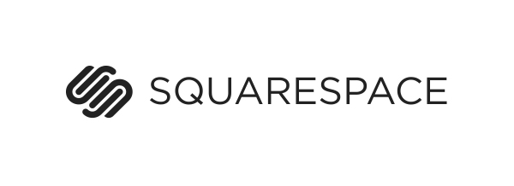
Introduction
Franklin Angulo, director of server engineering @ Squarespace
“Squarespace is a JavaShop and as such we provide support for Java microservices on top of what we call the Service Core”
Notes:
Explain migration from monolith to microservice

Slide 3
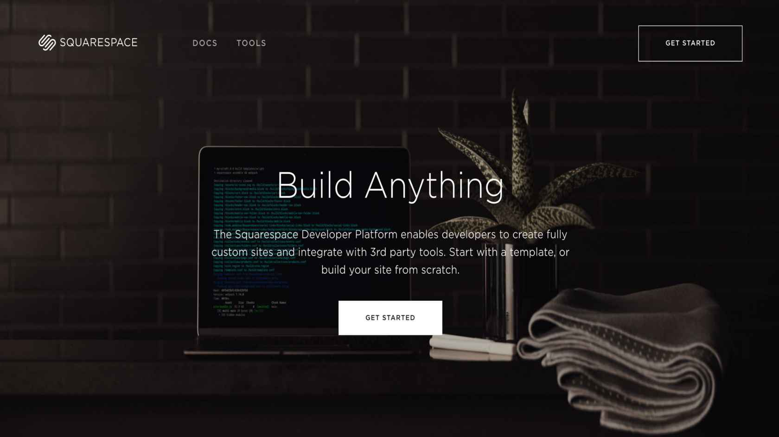
What is Squarespace?
Service Core
Service Client
Notes:
Explain what is Squarespace, service core and service client

Slide 4
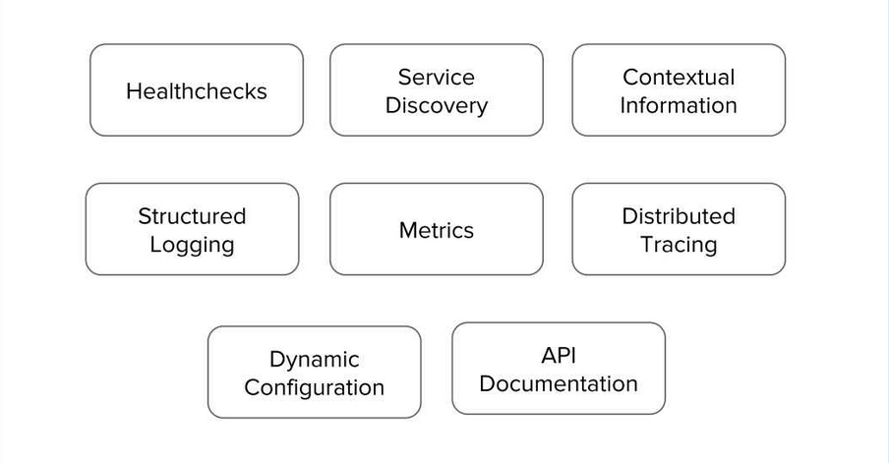
Service Core
Notes:
Explain the need for Service Core and it’s functionalities

Slide 5
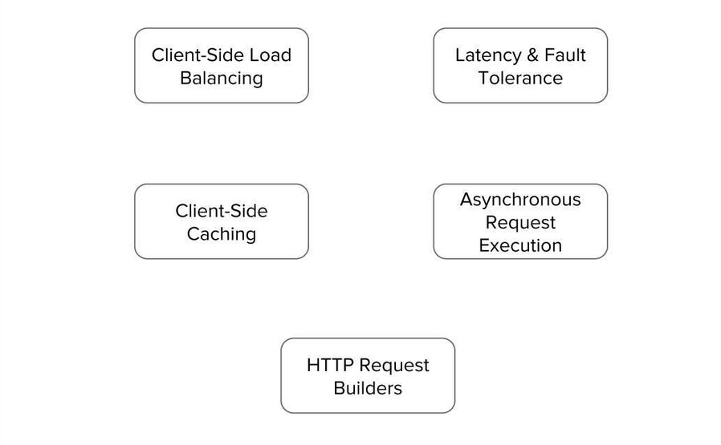
Service Client
Notes:
Explain the need for Service Client and it’s functionalities

Slide 6
Stakeholders
Developers
↓
Developers @ Squarespace
Clients
↓
People or organizations that buy a website/service in Squarespace
Users
↓
People that use the
Clients’ website/service
Notes:
Explain each stakeholder

Slide 7
Architecture Significant Requirements – ASR
Usability – How easy it is for the user to accomplish a desired task and the kind of user support the system provides
Performance – Software system’s ability to meet timing requirements
Availability – Ability of a system to mask and repair faults
Notes:
Usability - say how it is necessary to be easy to create and configure a website
Performance - requests of each website must not have much latency
Availability - it is imperative to have minimun downtime of the clients website and all services provided for then

Slide 8
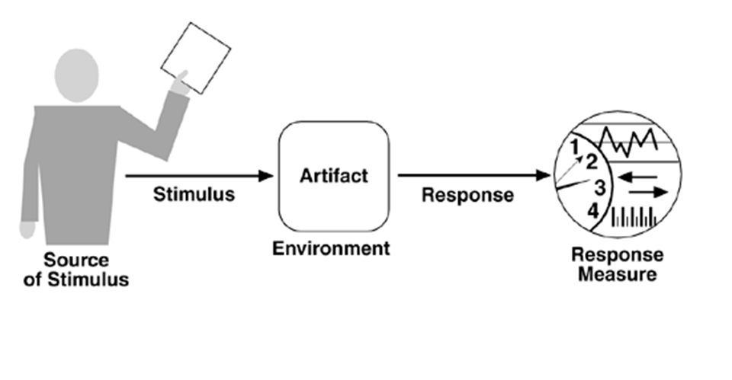
Usability Scenario
Swagger
Request for endpoint Information
Provide the user with an API of the endpoints and a UI where they can be tested.
Runtime
Client
User satisfaction
User Knowledge
Notes:
Specify that the UI allows to change the endpoint configurations without deploying each time

Slide 9
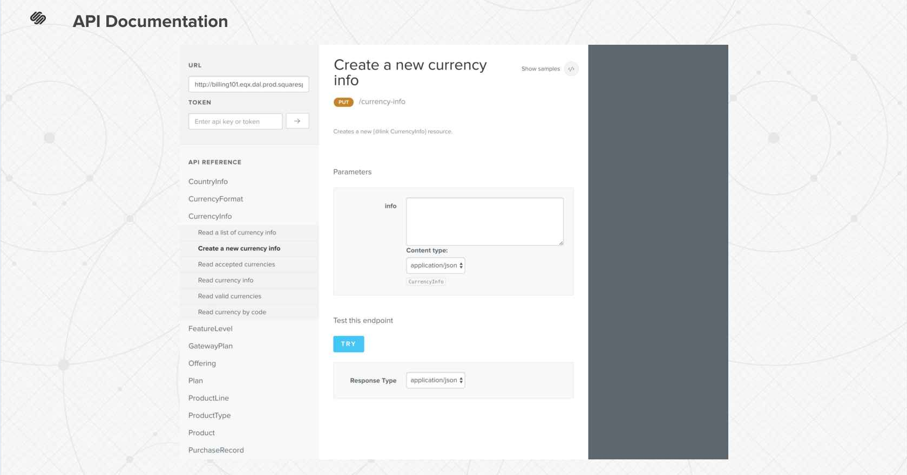
Usability Tactic
Notes:
Showcase the UI for endpoints

Slide 10
Usability Tactic
Tactic: Support System Initiative → Maintain Task Model
API documentation is embed into the service using Swagger to obtain information about endpoints
Its possible to try out the edpoints in the UI
Notes:
Say the swagger API is responsible for all information adquired and configurations of the endpoints

Slide 11
Performance Scenario I
Netflix Ribbon
User request to Server
Get already cached request
Normal Operation
User
Request response
time
Notes:
Say that after the first request to server the data can be preserved as cache.
Say that there is no necessity to send the request to the server if its already in cache.

Slide 12
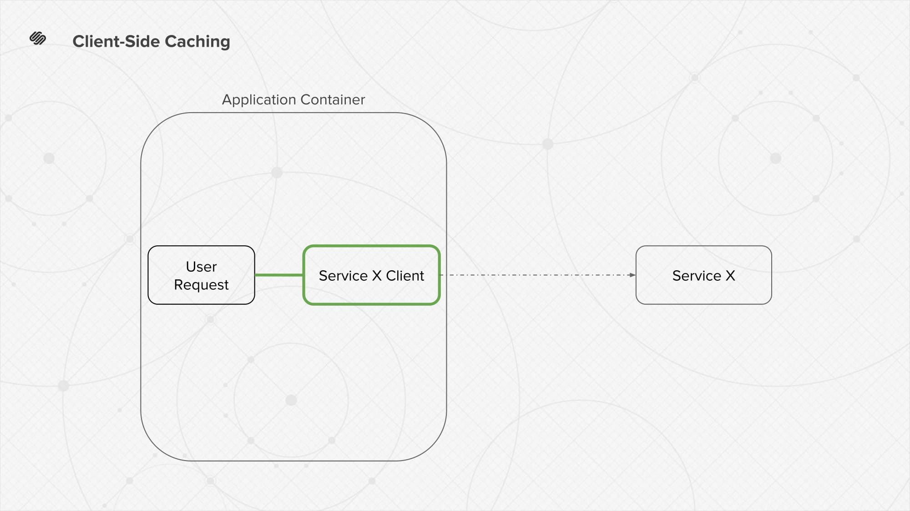
Performance Tactic I
Notes:
Explain chosen tactic
Explain advantages of caching

Slide 13
Performance Tactic I
Tactic: Manage Resources → Maintain Multiple copies of data.
Cache user request responses using Netflix Ribbon
Every time a user does a request to the server it checks if the response is cached
If the response is cached it is not necessary to ask the server, vastly reducing response time
Notes:
Say that the copies need to remain consistent and synchronized

Slide 14
Performance Scenario II
RxJava
Requests to multiple services
Concurrent requests to multiple services
Normal Operation
Service
Response time of
all requests
Notes:
Explain the problems os syncronous Execution

Slide 15
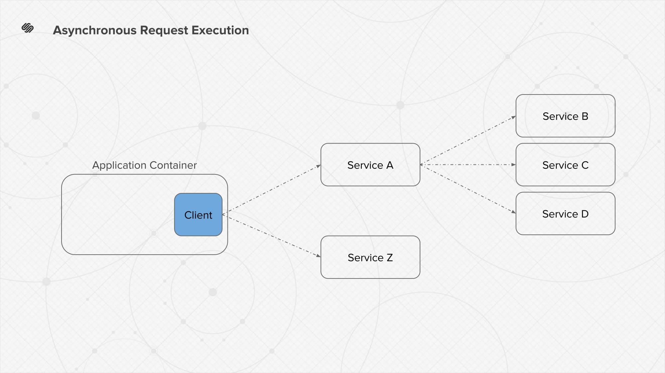
Performance Tactic II
Notes:
Explain the chosen tactic
Talk about of Asyncronous Execution

Slide 16
Performance Tactic II
Tactic: Manage Resources → Introduce concurrency.
A service needs to request multiple services without data dependency between them
The service does the requests concurrently instead of waiting for each response
Notes:
Explain possible relations with Performance

Slide 17
Availability Scenario
Netflix Hystrix
Service unavailable or has high latency issues
Service fails fast in order to prevent latency spread on other services
Normal Operation
Service
configuration
Notes:
Say this case Scenario is mainly to not allow other services to reach a fail state, but also has small improvement on performance

Slide 18
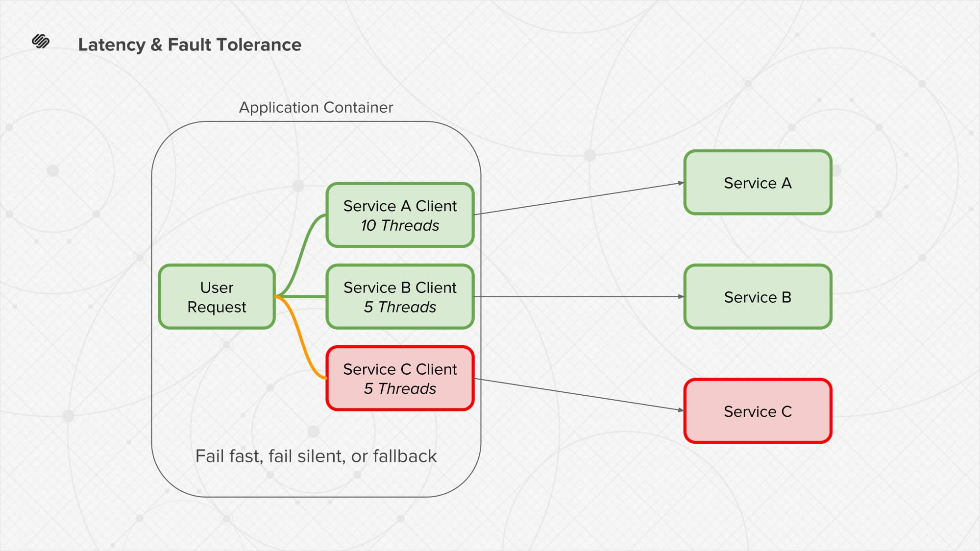
Availability Tactic
Notes:
Show that the Service C was faulty and it Fail fast to not fail the user requests

Slide 19
Availability Tactic
Tactic: Prevent Faults → Removal from service
Failure on a Service should not affect other services availability
Use Netflix Hystrix in other to fail fast problematic Service
Prevents other dependant Services of being affected
Notes:
Netflix Hystrix verifies if any Service is faulty and decides if it fast fails due to that

